Slide 1
American History

Slide 2
Module 4: The vacillating Giant
Talk | Title | Time Period | Date of Talk
23 | USA and the 20th Century | 1898-1900 | September 2nd
24 | The Progressive era | 1900-1916 | September 16th
25 | USA and world War One | 1914-1918 | October 21st
26 | The retreat to “normalcy’ | 1918-1920 | November 4th
26 | The Roaring Twenties | 1921-1929 | November 18th
27 | Great Depression and New Deal | 1929-1941 | December 2nd
29 | Isolationism interrupted | 1932-1941 | December 16th

Slide 3
American History
1
Talk 26: Retreat to Normalcy (1918-1920)

Slide 4
Talk 25: Retreat to ‘Normalcy’
Post War world and Treaty of Versailles
A society destabilised
Great Treaty Fight
1920 election

Slide 5
Post War world and Treaty of Versailles

Slide 6
Situation December 1918
Fighting in West has stopped
Allied armies demobilising (US army reduced from 4 million to 500,000 by end 1919
British, French Americans occupy Rhine cities
Germany facing financial ruin, civil war and starving
Army withdrawn and engaged in civil war vs Spartacists, monarchists
Blockade continues….500,000 will die during the winter
US has replaced Britain as the world premier financial power
Warfare across Eastern Europe
Russian Civil War, collapse of Russian, Austrian and Ottoman empires
Multiple ethnic wars breaking out “every ethnic group a nation”
Allied expeditions remain in Russians support “Whites”
..Churchill, Wilson “crusade vs Bolshevism

Slide 7
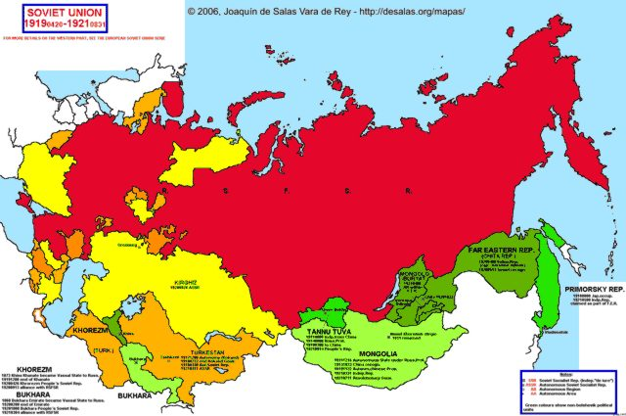
Russia 1918 & Allied expeditions
Situation Spring 1918
Bolshevik controlled mid 1918
White controlled
Archangel
1918-1919
First intervention:Archangel 1918-1919
objective: maintain war vs Germany
,,,40,000 British, 5,000 US August 1918
…White army collapse
….Bolsheviks attacks repulsed
Czech
Legion
Second intervention: Vladivostok: recover munitions, & rescue Czech Legion
….13,000 US, 2,000 British troops
… 50,000 Czech legion&
…Japan asked to contribute
….send 70,000 to secure gains
from war of 1905 with Czars)
Vladivostok
1918-1925

Slide 8
Russian Intervention 1919/1920
“Whites” ineffective
Bolsheviks and White atrocities
No alternative policies…..bring back the Czars
“Red Army” better led (Trotsky) and motivated
No appetite for renewed major war among allies
US retreats to isolation policy,
Socialists in France, Labour Party in Britain oppose war effort
Mutinies within Allied armies
Expeditions abandoned
Murmansk…White army destroyed, Reds attack allies, US leaves June 1919, rest Dec
Vladivostok: mess…. White army collapse, Czechs ship home….skirmishes
British, French, US leave 1920…. Japan1925 (after Treaty with Bolsheviks
Churchill (1949) “I think the day will come when it will be recognized without doubt…throughout the
civilized world, that the strangling of Bolshevism at its birth would have been an untold blessing to the
human race.”

Slide 9
World War the human cost …US relatively unaffected
Nation | WW1 Military Deaths | % males 10-40 year old
France | 1,400,000 | 20%
Britain | 880,000 | 18%
Germany | 2,000,000 | 15%
USA | 117,000 | 0.1%
Europe devastated, USA relatively untouched

Slide 10
USA the new world financial power
Debt Ratios % GDP during the war
 | 1914 | 1918
Britain | 15% | 120%
France | 22% | 103%
Germany | 6% | 150%
USA | 2% | 41%
US largest lender ….wants repayment
 | Debt to US in current dollars | Paid off
Britain | $65 Billion | 2006
France | $30 Billion | 1980
Russia | $5 Billion | …never paid..

Slide 11
World dominated by 3 surviving “Great Powers”: Americans, British and French …..Germans, Austrians, Ottomans defeated …..Russia and China in chaos Everything to be resolved at Versailles …..January 1919

Slide 12
Wilson’s Resolves to fix the world based on “14 Points”
“Peace without Victory: ”War fought to “make the world safe for democracy”
Create new European nations to be created based on ethnicity
Future treaties to be open and transparent
German and Ottoman colonies…to be run as “Mandates”
…………Palestine, Iraq, Syria, Lebanon
Leaves for Europe December 1918
………won’t return till July 1919

Slide 13
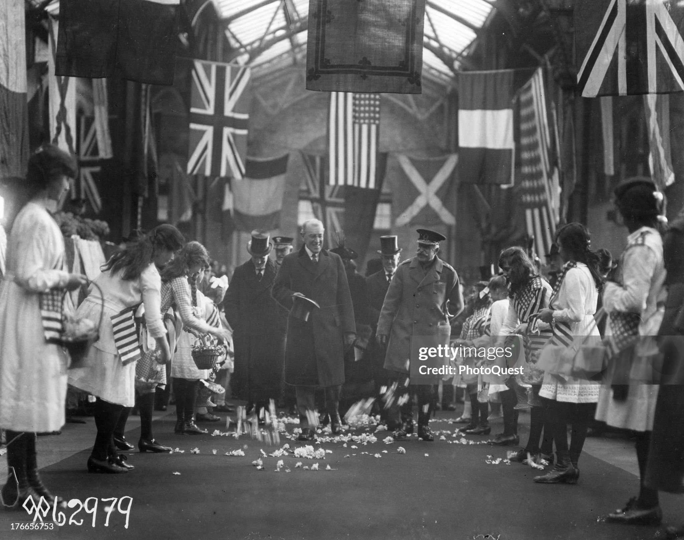
Wilson to Britain: "Hope for future”…British Press

Slide 14
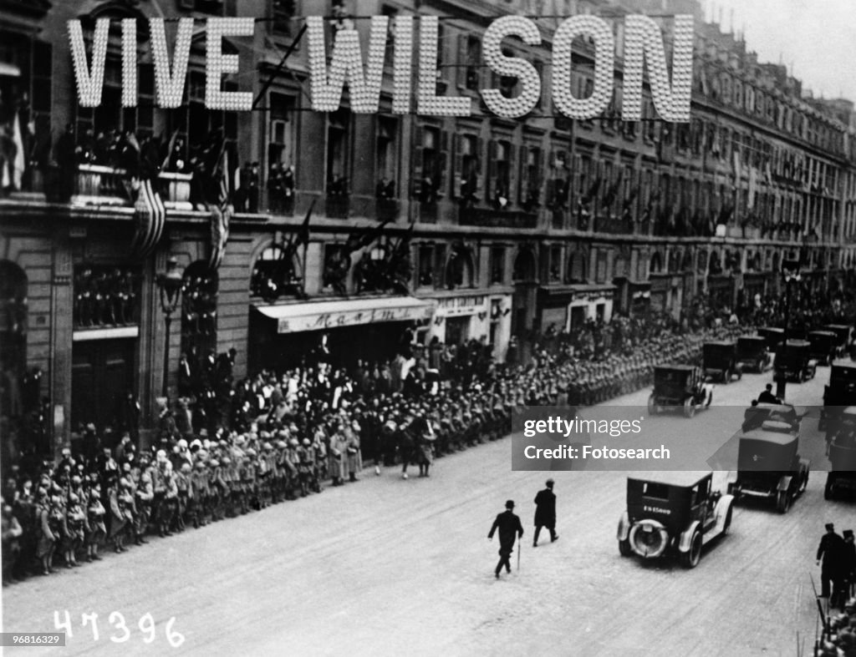
Wilson arrives in France to mass adulation

Slide 15
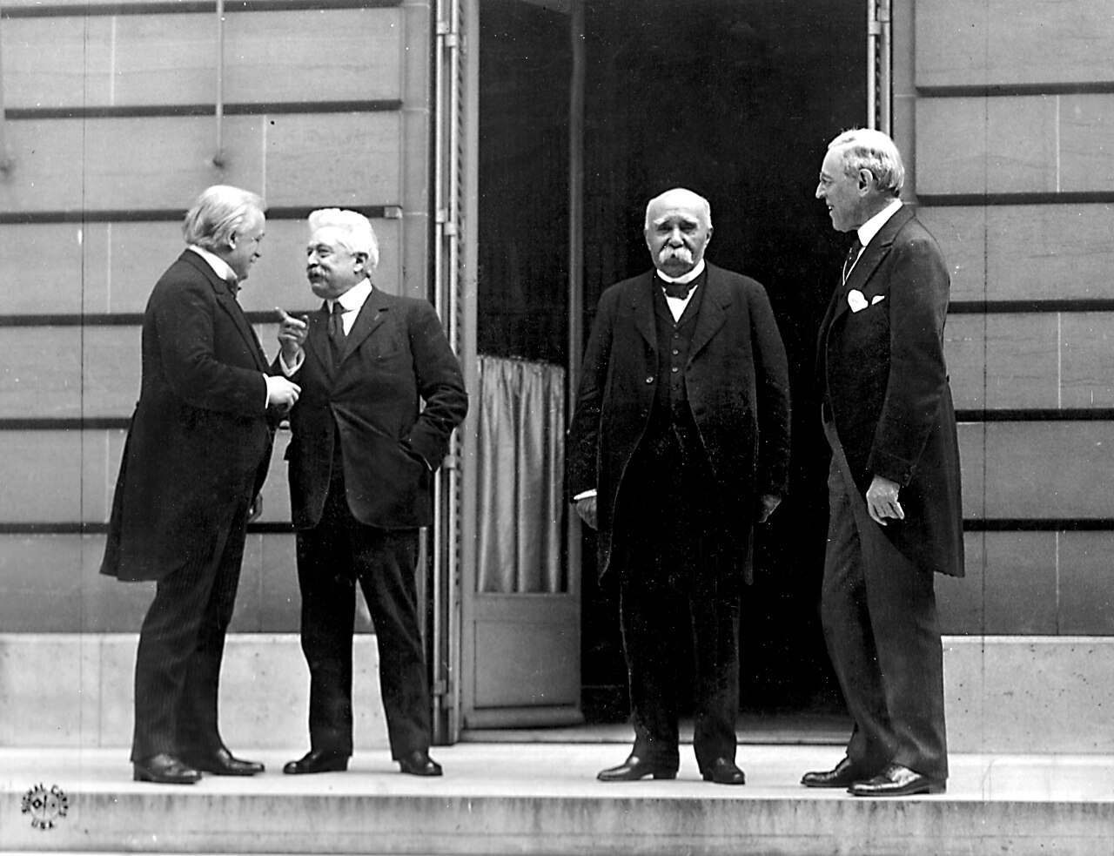
The “Big Four” at Versailles …
George
Clemenceau
France
Woodrow
Wilson
USA
Lloyd George
UK
Orlando
Italy

Slide 16
US Idealism vs European Realism
French (Clemenceau): Revenge
Destroy Germany, demilitarised, split up by new Rhineland Republic
Full indemnity for all French financial and human loss
“Fair share” German colonies, Ottoman Empire
Britain (Lloyd George): Financial recovery and Balance of Power
Rehabilitate Germany so that reparations can be paid
Recover world trade and financial position
Secure oil fields of Iraq & Kuwait to repay war debt
Italy: (Orlando) Reparations and Adriatic coast
Japan: Occupy German China colonies…..expand Empire
Germans not invited, neither are Soviets
….nor new Republic of China ( Sun Yat Sen)

Slide 17
Wilson’s “Vision snubbed”
Lloyd George about Wilson
“He would play a sublime part in the world’s history if he knew more about men and less about phrase”
“The trouble with Mr Wilson is that he believed every idea he had was a direct revelation from God and no one could dare challenge it”
Clemenceau about Wilson
“Mr. Wilson bores me with his Fourteen Points; why, God Almighty has only Ten”
“What can a mere French minister do when associated with Lloyd George, who thinks he is Napoleon, and Woodrow Wilson, who thinks he is Jesus Christ?”

Slide 18
The result: Treaty of Surrender
Germany treated as a vanquished not defeated nations
Reparations impossible to pay except by American loans
Institutionalised national humiliation…and impoverishment
Eastern Europe descend into chaos: multiple wars
Britain: access to (cheap) middle east oil (Iraq)
France: Revenge….(for now)
Japanese recognition as new power….licence to loot China

Slide 19
League of Nations
Officially created January 1920…Wilson awarded Nobel Peace Prize
Goals
Disarmament
Resolution of disputes by arbitration
Collective security…to support native peoples, end drug trafficking, slavery
No enforcement mechanism…depends on will of “Great Powers”
Wilson must secure agreement of Senate for USA to join
….lost control to Republicans in 1918 ‘mid terms”

Slide 20
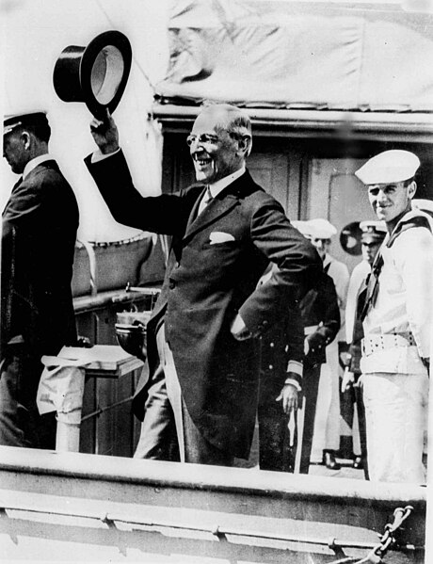
Wilson returns to US after 6 months away: world Messiah

Slide 21
The US to which Wilson returns in July 1919 not the same country he left in December 1918
USA :a Society destabilised

Slide 22
Spanish Influenza
Origins: two theories
Chinese “wet markets”…coolies to Western Front
US meat packing plants in Kansas to military bases to Europe
3 Waves & virus mutations
Spring 1918….75% troops infected…deaths as normal flu (.1%)
Autumn-Winter 1918….20% troops infected
….2 1/2% death rate (higher in places without sanitary facilities)
..spreads as troops start returning home
Spring 1919….highly infections, lower mortality (approx. 0.2%)
Spreads globally as soldiers return home

Slide 23
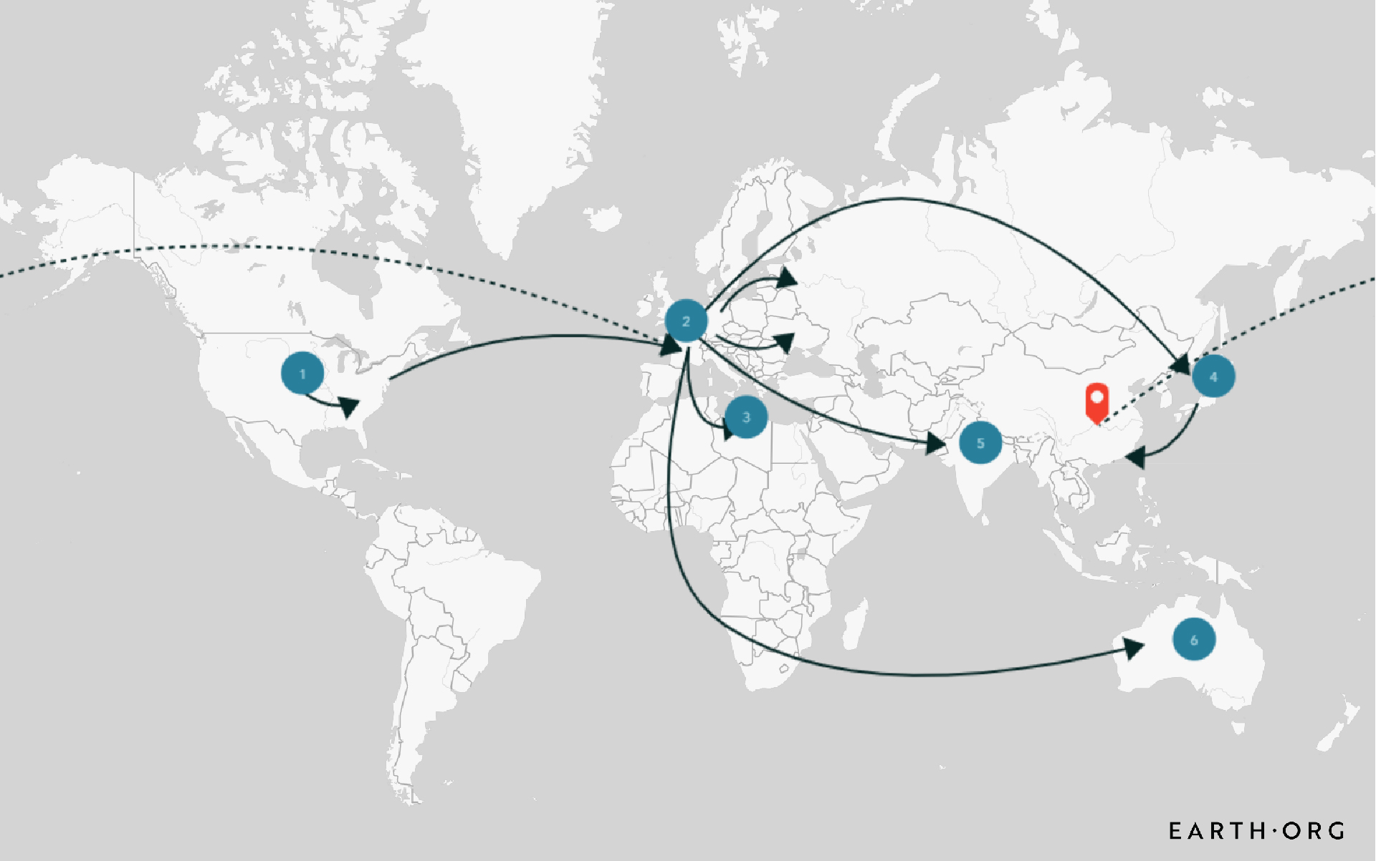
Global contagion as troops return home, Vladivostok expedition

Slide 24
Influenza Epidemic 1918-1920 50 million deaths…2.5% population vs 15m Coronavirus…0.2%)
country | Deaths | Population | %
India | 12,000,000 | 250,000,000 | 4.8%
South Africa | 300,000 | 7,000,000 | 4.3%
Indonesia | 1,500,000 | 42,000,000 | 3.6%
Mexico | 500,000 | 14,000,000 | 3.6%
China | 6,750,000 | 430,000,000 | 1.6%
Italy | 544,288 | 39,000,000 | 1.4%
Russia | 450,000 | 60,000,000 | 0.8%
Germany | 426,574 | 60,000,000 | 0.7%
Japan | 390,000 | 56,000,000 | 0.7%
United States | 675,000 | 106,000,000 | 0.6%
France | 237,509 | 40,000,000 | 0.6%
United Kingdom | 153,152 | 45,000,000 | 0.3%
Impact varies by density of population….
US reaction varies by state....no national campaign

Slide 25
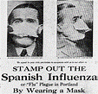
“Spanish Influenza” US public messages

Slide 26
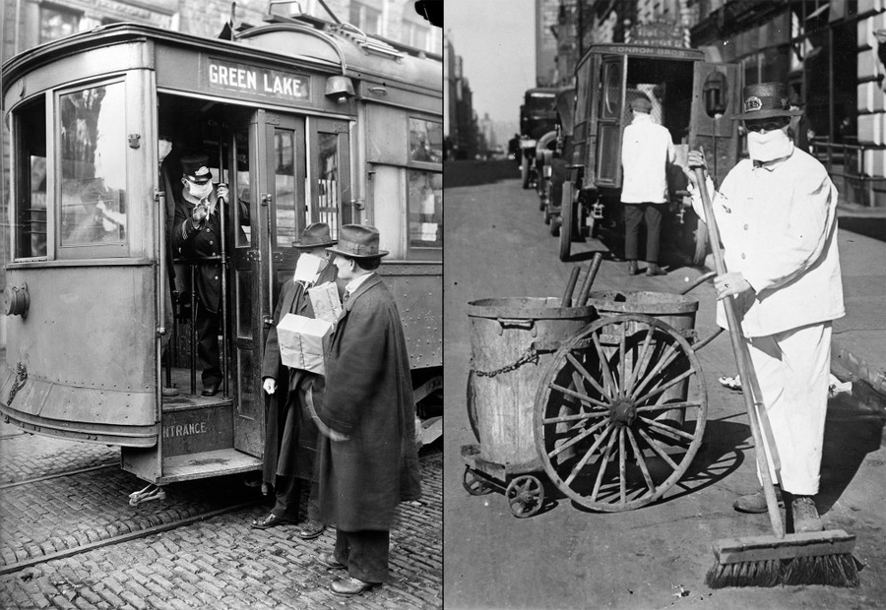
Seattle restrictions (“better ridiculous than dead”)

Slide 27
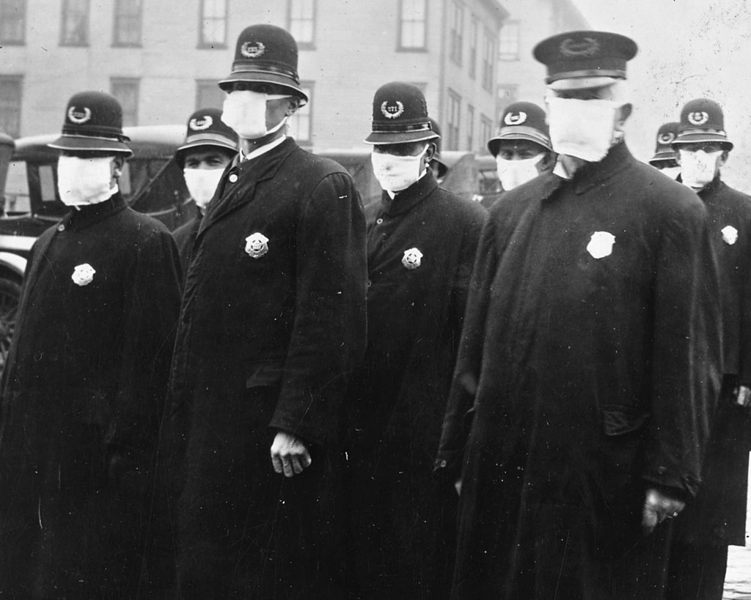
Police in Seattle

Slide 28
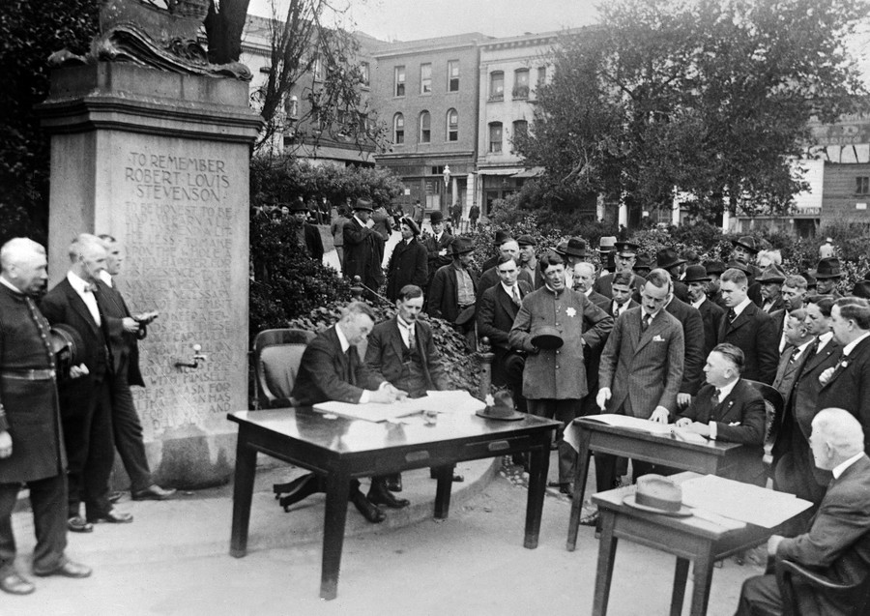
Seattle: open air courts

Slide 29
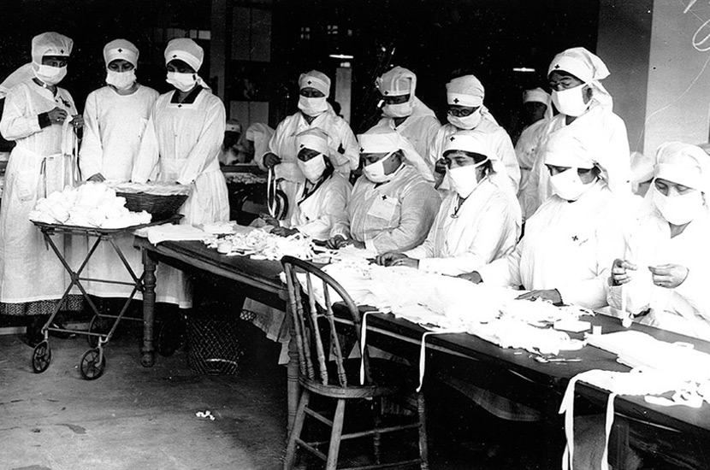
Assembling masks…Cincinnati 1918

Slide 30
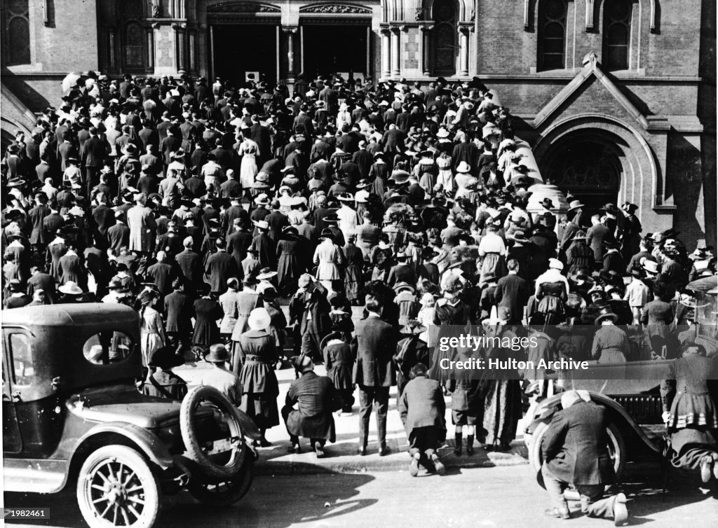
Ignored in other places: Mass prayer meeting Los Angeles

Slide 31
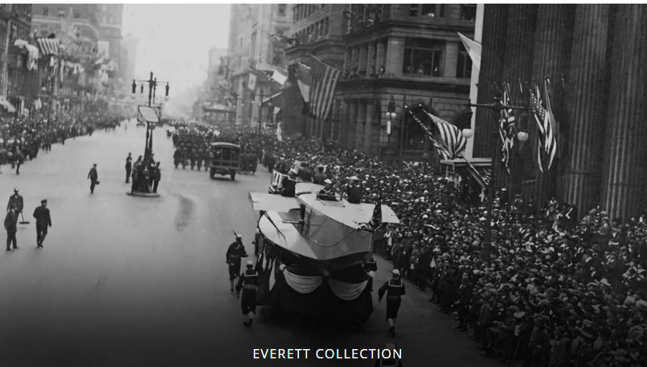
Victory Parade Philadelphia September 1918…200,000 attend…17,000 deaths within a month

Slide 32
US Reaction
675,000 deaths …10 x deaths from fighting
including 60,000 soldiers vs 50,000 from combat
Wilson reaction: None…except “thoughts and prayers”
His priority….getting Versailles Treaty approved by Senate
Health “State & City responsibility". Not Federal Government
Xenophobia ….disease due to “foreign influence” (despite probable local origin)

Slide 33
Great migrations

Slide 34
US Labour Market and WW1
US Economy grows rapidly during war
Munitions, food, manufactured goods, raw materials
4% business growth per year
4 million men mobilised…labour shortage
Movement of peoples…within North America
`Immigration collapses due to U Boat Threat & shipment disruption
White Women move to clerical jobs…..few to manufacturing
Gaps filled by migrants by migrations within North America

Slide 35
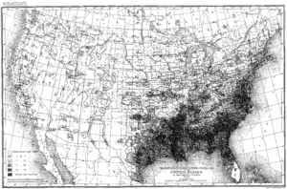
Black population 1900….95% in South

Slide 36
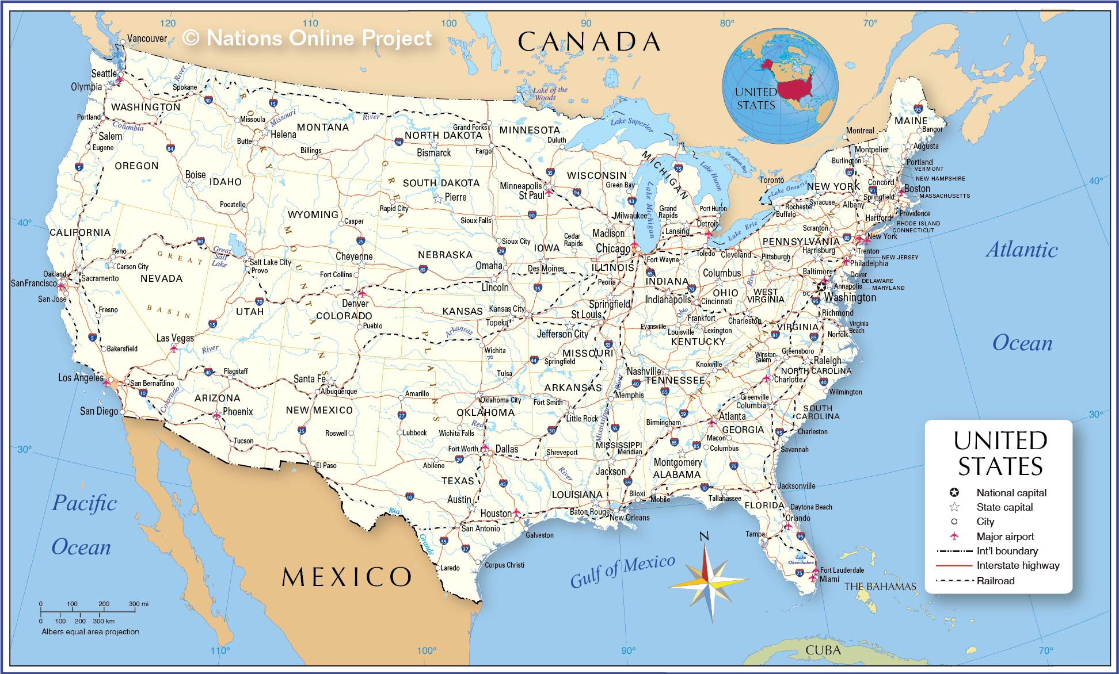
Great Migrations 1910-1920
Mexico to South West/Texas
Refugees from revolution
…. border porous
….reaches 100,000 per year
… area booming/more work
than people
South to North/Midwest
Refugees from Jim Crow
New “war” industries recruit
….Vulnerable to downturn
….Big city demographics change
500,000
1,000,000

Slide 37
Black population triples in Northern Cities
 |  | 1900 | 1920 | 1930
Chicago | Total | 1,700,000 | 2,700,000 | 3,400,000
 | Black | 30,000 (2%) | 110,000 (4%) | 320,000 (7%)
New York | Total | 3,400,000 | 5,600,000 | 6.900,000
 | Black | 60,000 (2%) | 160,000 (3% | 330,000 (6%)
Philadelphia | Total | 1,300,000 | 1,800,000 | 1,950,000
 | Black | 63,000 (5%) | 134,000 (7%) | 220,000 (9%)
Detroit | Total | 286,000 | 993,000 | 1,500,000
 | Black | 4,000 (1%) | 41,000 (4%) | 120,000 (8%)

Slide 38
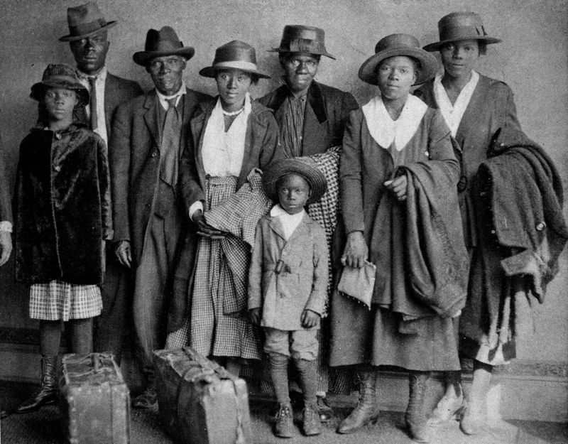
New arrivals Chicago 1920

Slide 39
Economic Downturn 1919-1920
War time production ends …rapidly
Economy growing 4% per year 1916-1920 shrinks 7% 1919/1920
Inflation at 15% due to shortages of materials/ labour
Wage cuts imposed across most industries
Army demobilised – reduced from 4,000,000 to 200,000 by end 1920
Unions empowered during war/ employers by its end
Wilson disengaged
….all that matters: getting League of Nations approved by
Republican controlled Senate

Slide 40
There is going to be trouble..1919…”Red Summer”

Slide 41
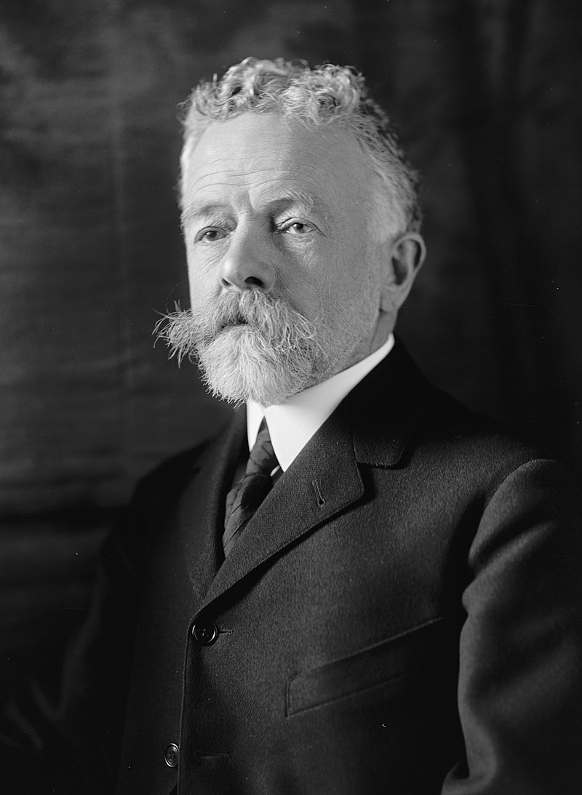
Republican Opposition
Henry Cabot Lodge
1850 -1924)
Massachusetts lawyer
& Ph.D. in History
“Progressive Republican”
Supports civil rights for blacks
Restrictions on immigration to
“more favored races”
Ridicules 14 points. Wilson naive
Internationalist, not US first
"I never expected to hate anyone in
politics with the hatred I feel toward
Wilson."

Slide 42
Isolationism
Lodge “Approves Treaty” …..but with “Reservations”
……“Supports “League but US must be premier power
…….no US involvement in wars of other nations
…….no other nation interference US and its business
“The United States is the world's best hope, but if you fetter her in the interests and quarrels of other nations, if you tangle her in the intrigues of Europe, you will destroy her power for good, and endanger her very existence. Leave her to march freely through the centuries to come, as in the years that have gone. Strong, generous, and confident, she has nobly served mankind. Beware how you trifle with your marvellous inheritance; this great land of ordered liberty. For if we stumble and fall, freedom and civilization everywhere will go down in ruin.”

Slide 43
Wilson Response
Cannot accept any “Reservations”…rejects Lodge
Any compromise with “isolationists” impossible
National Tour to “promote treaty to the people direct”
Collapses October 1919 stroke…incapacitated .. to White House
Mrs Wilson first assumes “stewardship” Female President?

Slide 44
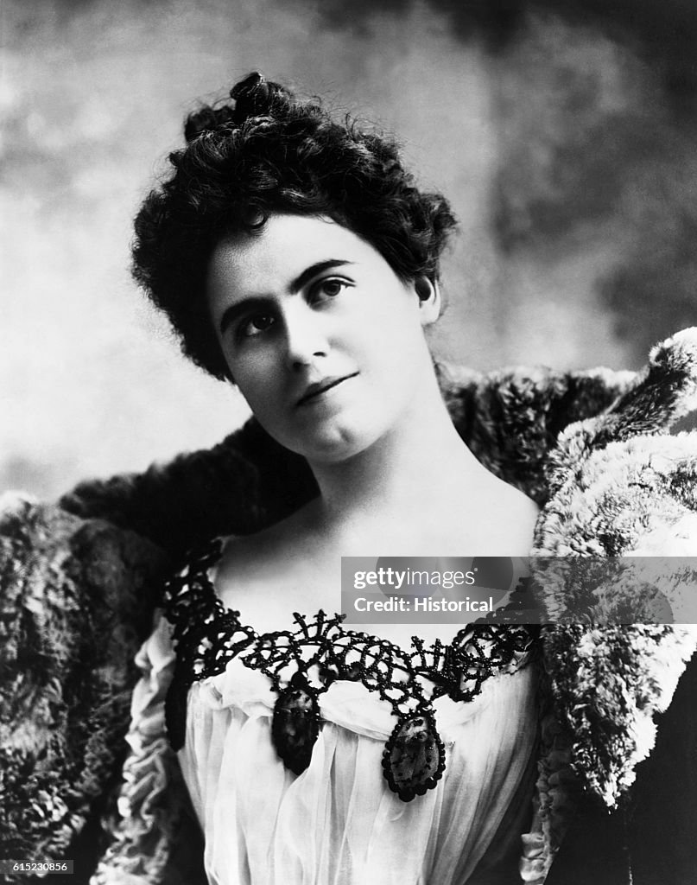
The reign of “Mrs Wilson”
Edith Wilson (1872-1961)
Wilson married Ellen Wilson 1883
3 children
Dies in White House 1914
Wilson depressed
Introduced to Edith Gault 1915
--wealthy widow
--”love at first sight
-- fear of scandal
--- marries W within year of wife’s death
Exemplary First Lady
--war time rationing at White House’
---un mowed lawn
---joins Wilson in Europe
---mixes with dignitaries

Slide 45
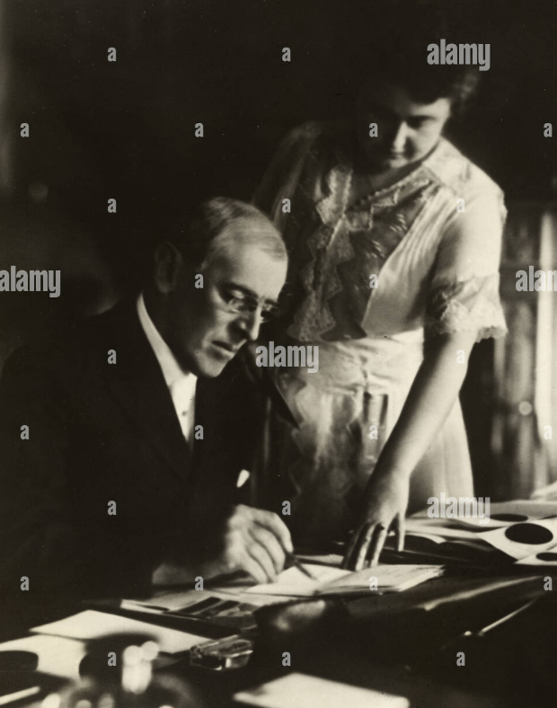
Woodrow and Edith …final year
Woodrow/ Edith share
hatred for VP Marshall
..no attempt to replace
invalid Wilson
Woodrow and Edith 1920
Edith….gate-keeper
--decides what WW sees
--WW invisible 6 months
No compromises made
On treaty….dies
Wilson recovers ability to
Speak July 1920
…Edith assists in meetings
--- Seeks re-election

Slide 46
Election of 1920

Slide 47
The candidates
Democrats
Wilson regains ability to talk April 1920 seeks re-election 3rd term
Discredited…Treaty unpopular….Wilson “sanctimonious”
Pick unknown Governor of Ohio…James Cox + Franklin Delano Roosevelt
Accept “reservations”…but public reject entire Treaty
Republicans
Blocked convention….unable to agree on candidate
Pick Ohio Senator…Warren Harding:
soothing voice/ inoffensive
Ran card games at house
Looked like “silent movie” star ….appeal to the ladies
Calvin Coolidge…breaker of Boston Police Strike VP

Slide 48
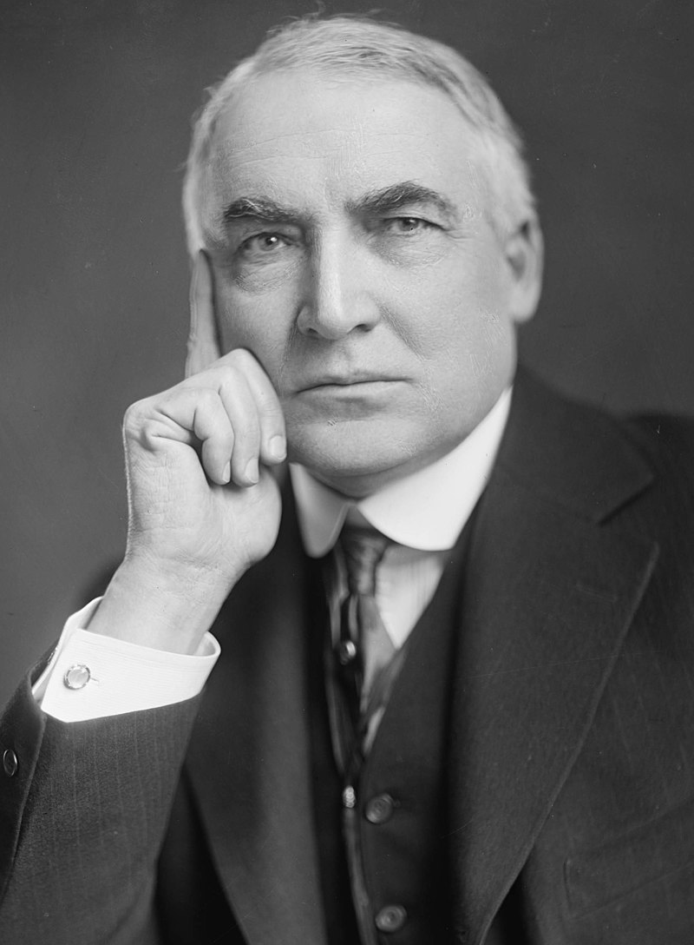
Warren Harding (1865-1923)
Newspaper executive
..State Senator
..Senate…inoffensive
Policies
…pro business/ anti union
…passive support repeal Jim Crow
..peace at home/ abroad
Effective public speaker
"a rambling, high-sounding mixture
of platitudes, patriotism, and pure
nonsense".
Captures tone of nation..
“America's present need is not heroics,
but healing; not nostrums, but normalcy
;not revolution, but restoration."

Slide 49
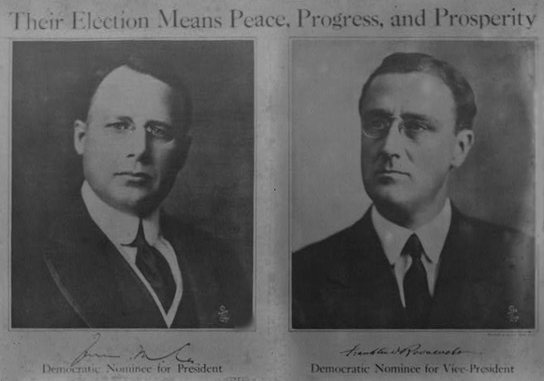
Democrat Poster: Peace for the world

Slide 50
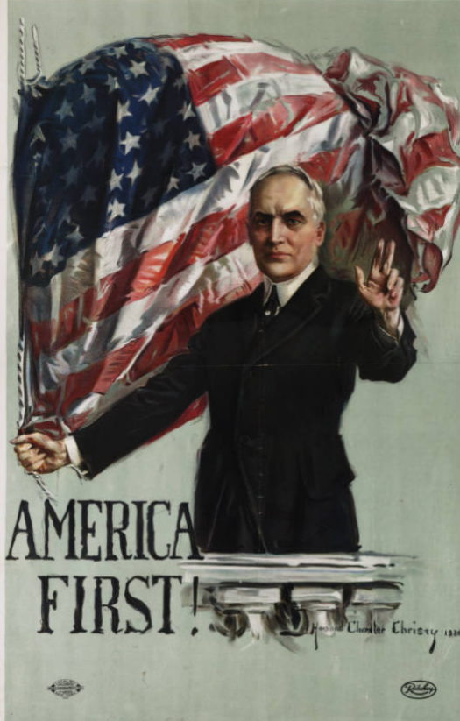
Republican “America First”…(Version 1)

Slide 51
The 1920 Choice
Approve Treaty….now with reservations
US World Leader
Low tariffs to expand Trade
Reform labour laws
White Supremacy
Democrats
“solemn referendum”
Reject Treaty
Disarm/ isolate
Impose Tariffs to protect industry
De regulate Industry/ restrict unions
No mention race
Republicans

Slide 52
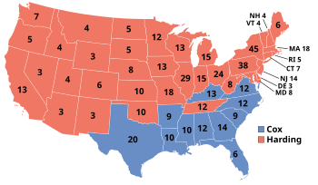
Republican Landslide
Republican Landslide
Harding: 16 million ----56% vote
Democrats :10 million ..…46%
Socialist (Debs in Jail) ..1 million…..4%
Message clear
…Normalcy is what people want
…..prosperity and peace
…USA not world’s policeman

Slide 53
As far as Americans of 1920 were concerned: ….the non US world not its problem ….all the US wanted was to be left alone & debts paid ….what mattered now was the prosperity of Americans
The Roaring Twenties were about to begin…..Talk 26

